Slide 1
Kentucky Integrated Eligibility and Enrollment System (IEES)
Commonwealth of Kentucky Cabinet for Health and Family Services
UAT Final
May 2, 2023

Slide 2
Table of Contents
Topic | Slide
PHE Scope | 3
PHE Testing Timelines | 4
SIT/UAT Scripting | 5
Reporting | 6
Regression | 10
Operational Readiness Testing (ORT) | 12

Slide 3
PHE Scope
CR | Release | Release Date | Part of PHE | SIT TCs | UAT TCs
CR 1619: Unwinding - Fair Hearing Extension | 23.05 | 6/2/2023 | Yes | 8 | 6
CR 1448: Medicaid Renewal Realignment | 23.03 | 3/17/2023 | Yes | 70 | 30
CR 1610: Unwinding | 23.03 | 3/31/2023 | Yes | 98 | 23
CR 1613: Facilitated Enrollment – Unwinding | 23.03 | 3/31/2023 | Yes | 30 | 11
CR 1621: Returned Mail Bot | 23.03 | 3/31/2023 | Yes | 96 | 52
CR 1623: Unwinding Passive Renewals – AVS | 23.03 | 3/31/2023 | Yes | 12 | 5
End to End Regression Testing Based on Changes Delivered since March 2020 | 23.03 | 3/31/2023 | Yes | 138 | 44
CR 1767: PHE Unwinding Reporting I | 23.04 | 4/28/2023 | Yes | 21 | 12
CR 1782: SBM Unwinding Metrics Reporting | 23.04 | 4/28/2023 | Yes | 11 | 4
CR 1616: Renewal Nudges | Already In Prod(22.07. Phase 1 22.11. Phase 2 22.12. Phase 3) | N/A | Yes | N/A | N/A
CR 1626: MRT Decision Automation | Already In Prod(22.09) | N/A | No | N/A | N/A
Notes: All items above are related to PHE but not all items will be a part of the initial PHE window. Items highlighted in green have already been deployed to PROD.

Slide 4
Testing Timeline
PHE Releases | Testing Timelines (SIT/UAT) | Alignment with M&O Releases | Jan ’23 | Feb ‘23 | March ’23 | April ’23 | May '23
Release 23.03 | SIT Testing | M& Go live 3/31
 | UAT Testing
Release 23.04 | SIT Testing | M& Go live 4/28
 | UAT Testing
Release 23.05 | SIT Testing | M& Go live 6/2
 | UAT Testing
Notes:
All PHE UAT timelines will be merged with M&O GO Lives Dates for better alignment with other changes being delivered as a part of the regular monthly releases.

Slide 5
OATS UAT Test Case Scripting/Selection
Test Cases count | SIT TC Count | UAT TC Count
Release 23.03 | 306 | 121
Release 23.04 | 32 | 16
Release 23.05 | 8 | 6
The above UAT Test case counts are approx. 60% of Total SIT planned test cases. Historically, this is a method used for UAT Test case planning
OATS Team can review the current SIT Test Bed and finalize the Total Test Scenario and decide if additional coverage beyond 60% is needed. Sometimes testing is merged so the UAT count may equal out to less than 60%.
Release 23.05 SIT/UAT is underway

Slide 6
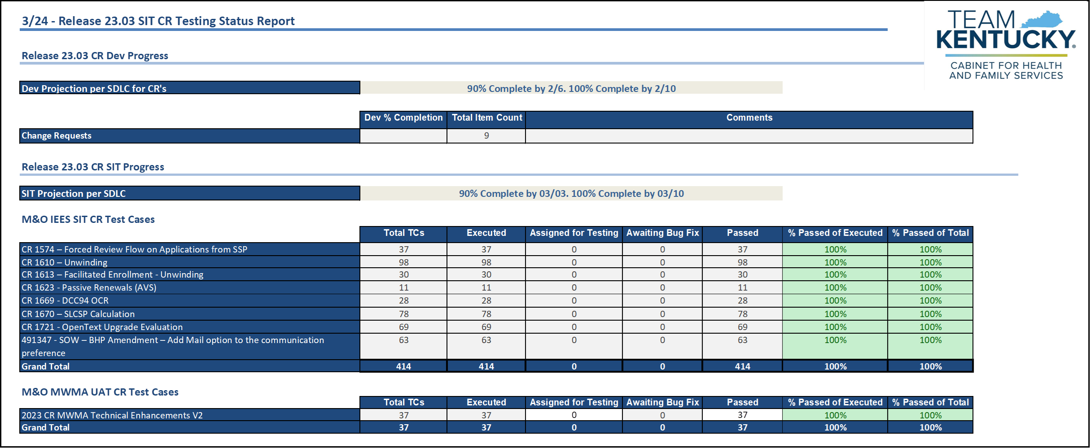
Weekly Cadence: 23.03 SIT Reporting
Daily reporting of test case execution and defects found was provided during PHE testing. Below is an example of 23.03 reports for
SIT.

Slide 7
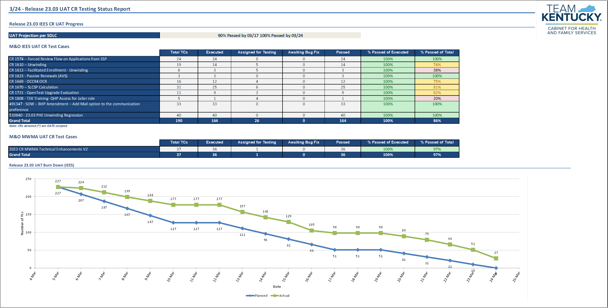
Weekly Cadence: 23.03 UAT Reporting
Daily reporting of test case execution and defects found was provided during PHE testing. Below is an example of 23.03 reports for
UAT.

Slide 8
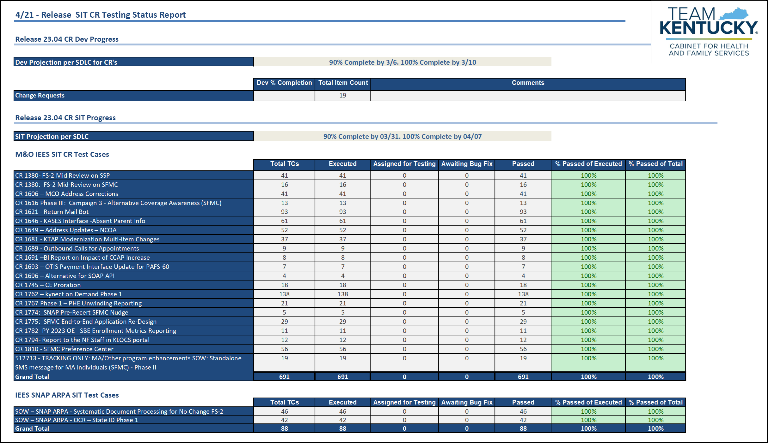
Weekly Cadence: 23.04 SIT Reporting
Daily reporting of test case execution and defects found was provided during PHE testing. Below is an example of 23.04 reports for
SIT.

Slide 9
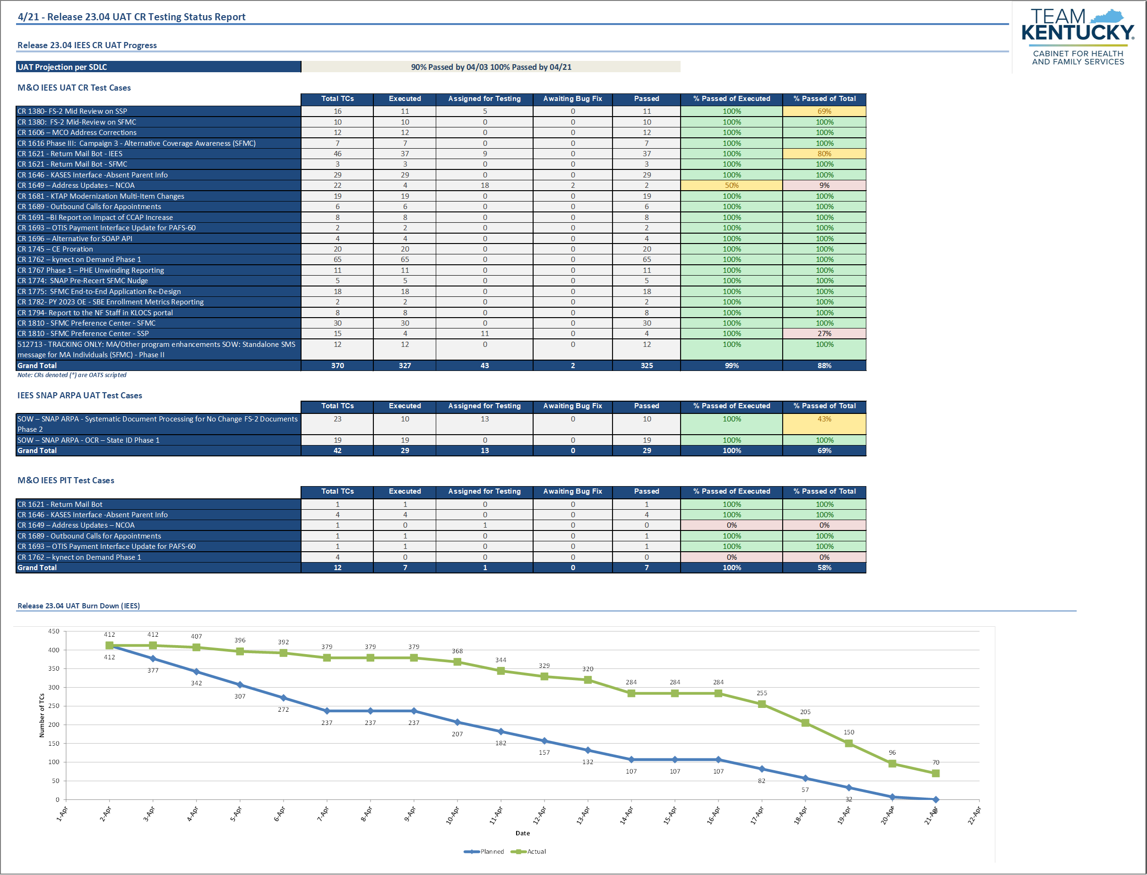
Weekly Cadence: 23.04 UAT Reporting
Daily reporting of test case execution and defects found was provided during PHE testing. Below is an example of 23.04 reports for
UAT.

Slide 10
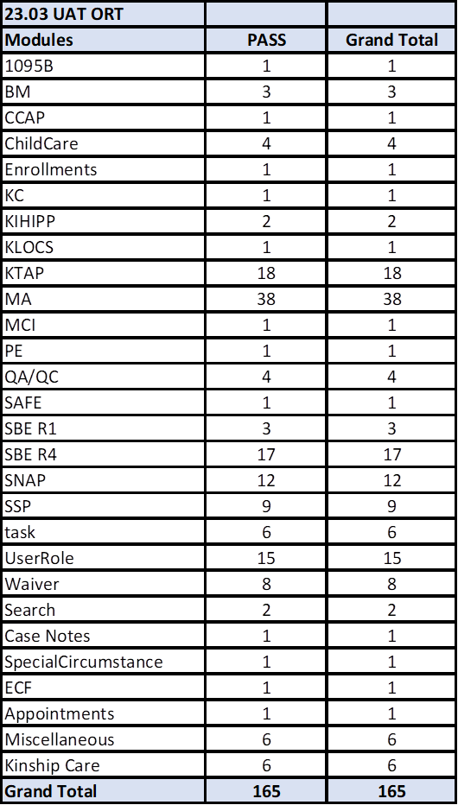
Regression Testing included the re-execution of PHE scenarios to ensure that the constant builds into the wider system that were already executed were not altered by the frequent weekly UAT builds. A robust master Regression suite was executed post code freeze to ensure end to end health check of the system as a whole. Below is the regression suite executed and reviewed by OATS at the end of 23.03 (3/31/23).
23.03 Automated Regression

Slide 11
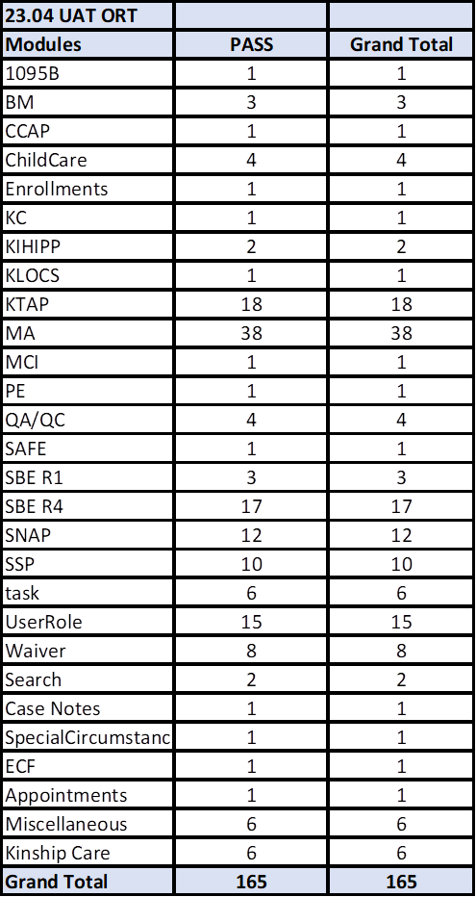
Regression Testing included the re-execution of PHE scenarios to ensure that the constant builds into the wider system that were already executed were not altered by the frequent weekly UAT builds. A robust master Regression suite was executed post code freeze to ensure end to end health check of the system as a whole. Below is the regression suite executed and reviewed by OATS at the end of 23.04 (4/28/23).
23.04 Automated Regression

Slide 12
23.03 Operational Readiness Testing (ORT)
UAT testers executed a set of manual test cases to ensure that the constant CR specific builds into the wider system executed early in the release month were not altered by the frequent weekly UAT builds. Below is a snapshot of the manual ORT + automation counts for 23.03.
Release 23.03 ORT
 | Total TCs | Executed | Pending | Passed | % Passed of Executed | % Passed of Total
Manual ORT - PHE Focused | 14 | 14 | 0 | 14 | 100% | 100%
Manual M&O ORT | 15 | 15 | 0 | 15 | 100% | 100%
Automation ORT | 166 | 166 | 0 | 166 | 100% | 100%
Total | 195 | 195 | 0 | 195 | 100% | 100%

Slide 13
23.04 Operational Readiness Testing (ORT)
UAT testers executed a set of manual test cases to ensure that the constant CR specific builds into the wider system executed early in the release month were not altered by the frequent weekly UAT builds. Below is a snapshot of the manual ORT + automation counts for 23.04.
Release 23.04 ORT
 | Total TCs | Executed | Pending | Passed | % Passed of Executed | % Passed of Total
Manual M&O ORT | 36 | 36 | 0 | 36 | 100% | 100%
Automation ORT | 166 | 166 | 0 | 166 | 100% | 100%
Total | 202 | 202 | 0 | 202 | 100% | 100%

Slide 14
PHE Scope
CR | Release | Release Date | Part of PHE | SIT TCs | UAT TCs
CR 1619: Unwinding - Fair Hearing - extends the time to take final administrative action | 23.05 | 6/2/2023 | No | 8 | 6
CR 1448: Medicaid Renewal Realignment - redistribute the accumulated case load. The cases will be distributed based on agency provided threshold limits and other distribution factors such as a prioritization based on age and potential QHP qualification. | 23.03 | 3/17/2023 | Yes | 70 | 30
CR 1610: Unwinding - IEES will rollback changes made at the beginning of the PHE as well as allowing continuous eligibility until the Medicaid renewal is complete. | 23.03 | 3/31/2023 | Yes | 98 | 23
CR 1613: Facilitated Enrollment – Unwinding - allows IEES to leverage SNAP eligibility data during the ex-parte renewal process in order to re-determine Medicaid eligibility. | 23.03 | 3/31/2023 | Yes | 30 | 11
CR 1621: Returned Mail Bot - IEES will systematically read returned mail and perform the required updates, including outreach (robocalls, nudges) and the addition of a message to Worker Portal and Self Service Portal to those who have returned mail. | 23.03 | 4/28/2023 | Yes | 96 | 52
CR 1623: Unwinding Passive Renewals – AVS - IEES will not generate a Request for Information (RFI) for resources when the Asset Verification Service (AVS) returns zero results. | 23.03 | 3/31/2023 | Yes | 12 | 5
End to End Regression Testing Based on Changes Delivered since March 2020 | 23.03 | 3/31/2023 | Yes | 138 | 44
CR 1767: PHE Unwinding Reporting I - reporting on the PHE Unwinding and Medicaid renewal metrics. This includes data required from CMS and for the Secretary, as outlined in Section D of the Consolidated Care Act 2023. | 23.04 | 4/28/2023 | Yes | 21 | 12
CR 1782: SBM Unwinding Metrics Reporting SBM Data Reporting During Medicaid/CHIP Continuous Coverage Unwinding. Submit monthly data to CMS on eligibility and enrollment actions conducted between April 1, 2023, through June 30, 202. Include Priority Metrics as specified by CMS. | 23.04 | 4/28/2023 | Yes | 11 | 4
 |  |  | Total | 484 | 187
Notes: Notes: All items above are related to PHE CRs and regression that will cover all CRs deployed to production since March of 2020. For Operational Readiness Testing (ORT) scripts please refer to slide 7.

Slide 15
About Deloitte Deloitte refers to one or more of Deloitte Touche Tohmatsu Limited, a UK private company limited by guarantee (“DTTL”), its network of member firms, and their related entities. DTTL and each of its member firms are legally separate and independent entities. DTTL (also referred to as “Deloitte Global”) does not provide services to clients. Please see www.deloitte.com/about for a detailed description of DTTL and its member firms. Please see www.deloitte.com/us/about for a detailed description of the legal structure of Deloitte LLP and its subsidiaries. Certain services may not be available to attest clients under the rules and regulations of public accounting. Copyright © 2020 Deloitte Development LLC. All rights reserved. 36 USC 220506

