Slide 1
Virtual Stakeholder Forum
Sept. 26, 2024

Slide 2
Welcome
Medicaid Updates: Recovery Month, Provider Forums, & Waiver Slots
Service Expansion Updates: CHWs + Hearing, Dental, and Vision Services
Member Renewals and Eligibility
Reentry Update
Provider Appeals and Complaints
Program Spotlight: Behavioral Health Initiatives

Slide 3
Provider Forum Update

Slide 4
Medicaid Provider Forums
BOWLING GREEN
OWENSBORO
Medicaid Updates
Meet Our Sister Agencies
Division Meet and Greet Session
MCO Provider Representatives
LOUISVILLE
COVINGTON

Slide 5
Register for an Upcoming Forum
Covington
Morehead
Pineville

Slide 6
Recovery Month Update

Slide 7
Celebrating Recovery Month
Sharing Stories of Hope and Resilience
89
3
Gov. Andy Beshear
DPH Commissioner Dr. Steven Stack
Partner Agencies
Bill Signings
Sec. Eric Friedlander
ODCP Ex. Director Van Ingram
3
1
DMS Commissioner Lisa Lee
New Recovery Ready Communities
Governor
Proclamation
BHDID Director Sarah Johnson
4
Individuals in long-term recovery shared personal testimonials.

Slide 8
Hope and healing
Save the Date
Sept. 15, 2025
10:30 a.m. to 2 p.m.
Kentucky State Capitol, South Lawn

Slide 9
Waiver Slot Update

Slide 10
Additional Waiver Slots
CMS approval for additional waiver slots is pending
Michelle P.
Acquired Brain Injury
Long-Term Care
750 new; 250 current Fiscal Year
50 new; 25 current Fiscal Year
Home and Community Based Services
Supports for Community Living
750 new; 250 current Fiscal Year
375 new; 125 current Fiscal Year

Slide 11
Community Health Workers; Adult Hearing, Dental, & Vision Services

Slide 12
New Service Provider: Community Health Workers
Began billing Medicaid July 1, 2023
39 providers billed
Approximately $35,000
Approximately 1,218 members
12

Slide 13
Vision, Hearing,&
Dental Expansion
Approximately 7,150 dentures
Over 2,500 crowns
831 root canals
150 hearing aids
113,100 pairs of glasses
13

Slide 14
Member Renewals and Eligibility

Slide 15
Public Health Emergency (PHE) Unwinding
2023
2024
May
Jun
Jul
Aug
Sep
Oct
Nov
Dec
Jan
Feb
Mar
Apr
May
Jun
Last PHE renewals for adults had a due date of May 31 with the exception of June 30 for 8 individuals.
Ongoing annual renewals for non-PHE cases resumed in April 2024.
Flexibilities in place through June 2025.
Certain Appendix K flexibilities made permanent in 1915(c) waivers effective May 1, 2024.
CMS monthly and updated reporting ongoing.

Slide 16
Medicaid Enrollment Trend
16

Slide 17
Unwinding Report Updates Posted
Original CMS Monthly Reports
Updated CMS Monthly Reports*
 | Individual Renewals | Medicaid Approvals | Medicaid Terminations | Pending
May | 80,673 | 37,182 | 34,124 | 2,698
Jun | 82,606 | 37,364 | 35,971 | 1,883
Jul | 54,975 | 27,044 | 20,344 | 1,325
Aug | 54,344 | 28,296 | 18,662 | 1,069
Sept | 150,985 | 81,144 | 16,617 | 16
Oct | 155,003 | 92,524 | 12,780 | 15
Nov | 31,863 | 22,888 | 1,508 | 38
Dec | 30,705 | 28,889 | 1,244 | 2
90-Day
Processing Period
 | Individual Renewals | Medicaid Approvals | Medicaid Terminations | Pending
May | 80,673 | 38,552 | 35,413 | 39
Jun | 82,606 | 38,236 | 36,967 | 15
Jul | 54,975 | 27,775 | 20,900 | 38
Aug | 54,344 | 28,853 | 19,169 | 5
Sept | 150,985 | 81,156 | 16,169 | 2
Oct | 155,003 | 92,528 | 12,783 | 8
Nov | 31,863 | 22,900 | 1,529 | 5
Dec | 30,705 | 28,891 | 1,244 | 0
2,659 processed
1868 processed
1,287 processed
1064 processed
14 processed
7 processed
33 processed
2 processed
*Per CMS' Medicaid and Children’s Health Insurance Program Eligibility and Enrollment Data Specifications for Reporting During Unwinding, Updated October 2023, Version 3.

Slide 18
Unwinding Report Updates Posted – Cont’d
Original CMS Monthly Reports
Updated CMS Monthly Reports*
 | Individual Renewals | Medicaid Approvals | Medicaid Terminations | Pending
Jan | 79,053 | 67,748 | 10,899 | 22
Feb | 93,004 | 64,789 | 10,128 | 1
Mar | 97,962 | 70,358 | 7,932 | 72
Apr | 103,265 | 70,170 | 15,887 | 226
May | 94,705 | 51,534 | 37,461 | 816
90-Day
Processing Period
 | Individual Renewals | Medicaid Approvals | Medicaid Terminations | Pending
Jan | 79,053 | 67,758 | 10,911 | 0
Feb | 93,004 | 64,780 | 10,128 | 0
Mar | 97,962 | 70,404 | 7,958 | 0
Apr | 103,265 | 70,266 | 16,017 | 0
May | 94,705 | 51,938 | 42,747 | 0
22 processed
1 processed
72 processed
226 processed
816 processed
*Per CMS' Medicaid and Children’s Health Insurance Program Eligibility and Enrollment Data Specifications for Reporting During Unwinding, Updated October 2023, Version 3.

Slide 19
KY Medicaid Renewals* and Reinstatements
Individuals procedurally terminated on their renewal due date are given 90 days to respond and provide requested information. If they are determined eligible, coverage is reinstated back to their termination date. Months that are still within the 90-day window and are still processing reinstatements are included below.
 | Individual Renewals | Medicaid Approvals | Medicaid Terminations | Pending | Extended
June | 58,959 | 41,336 | 13,187 | 1 | 4,435
July | 40,719 | 36,036 | 1,187 | 0 | 3,496
August | 36,136 | 31,823 | 979 | 2 | 3,332
Reinstatements as of 09/13/24
628
533
163
*Numbers are based on CMS Reports.
19

Slide 20
Renewals: Need help?
There are people in every community who can help!
kynector or licensed insurance agent available online and by calling 1-855-4kynect (1-855-459-6368)
If you’re 65+ call the SHIP Hotline at (877) 293-7447 (option #2) or call DAIL at (502) 564-6930 and ask for a SHIP counselor to learn about Medicare options!
Resources on Kentucky’s website for all things Medicaid Renewals and PHE Unwinding!
MedicaidUnwinding.ky.gov
20

Slide 21
Providers Supporting Patients Through Renewals
Here is how to find your patient’s renewal date in KYHealthNet.
21

Slide 22
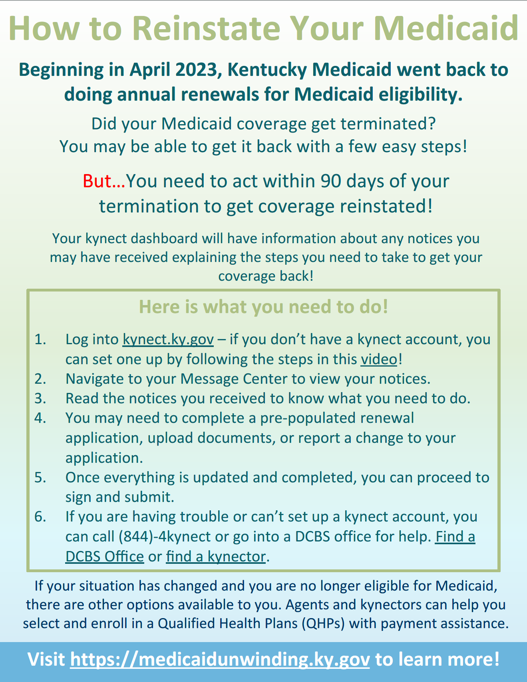
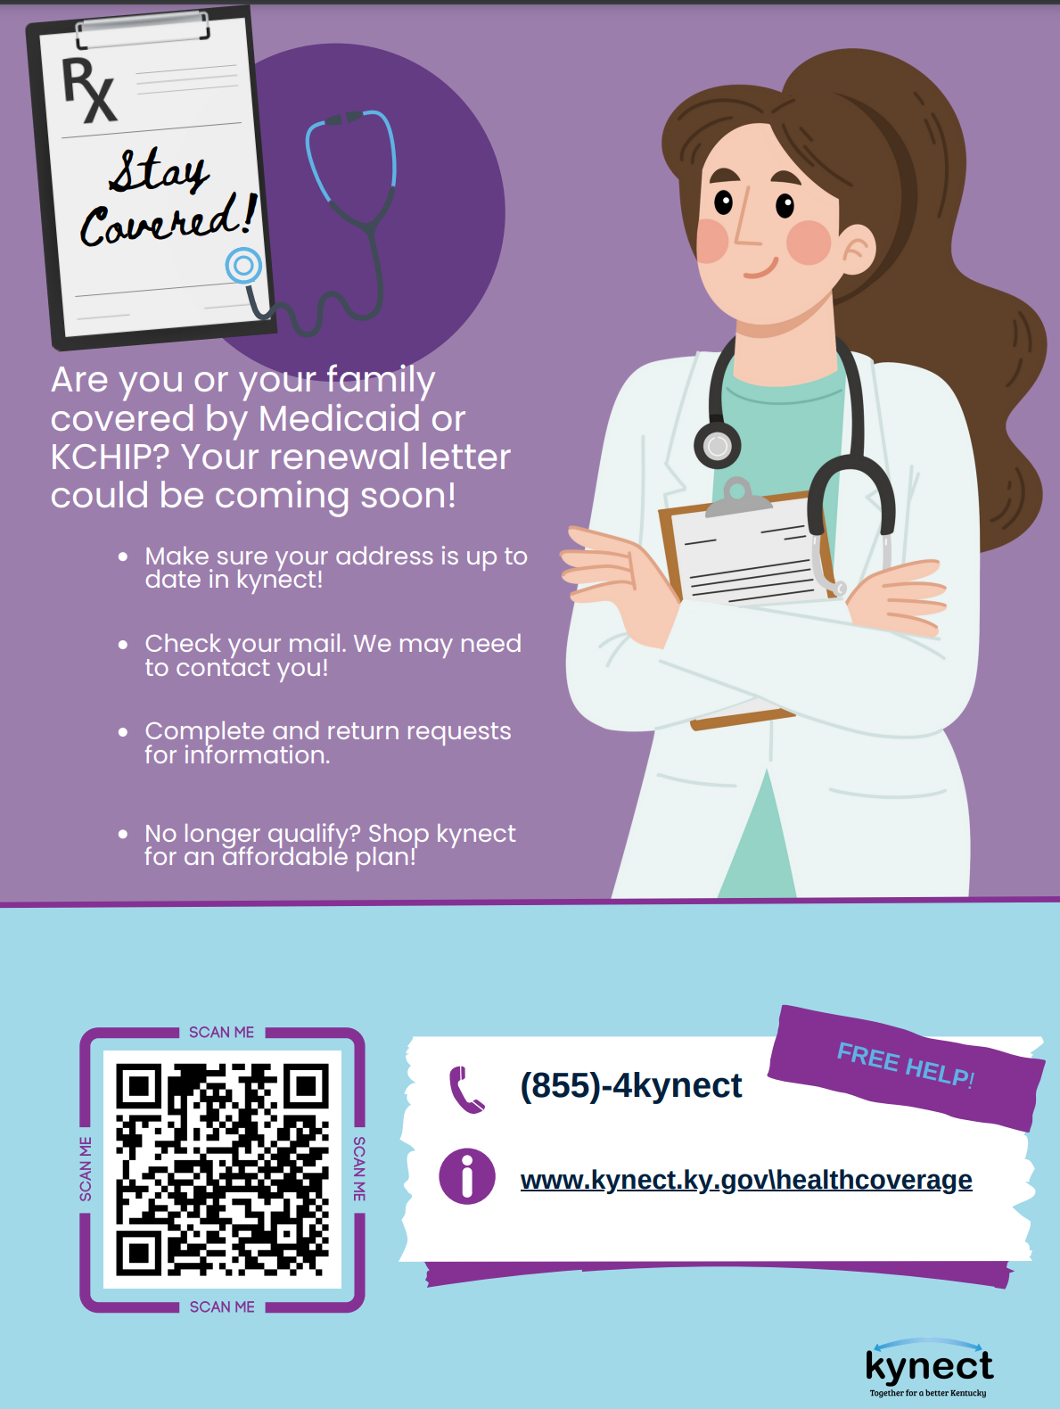
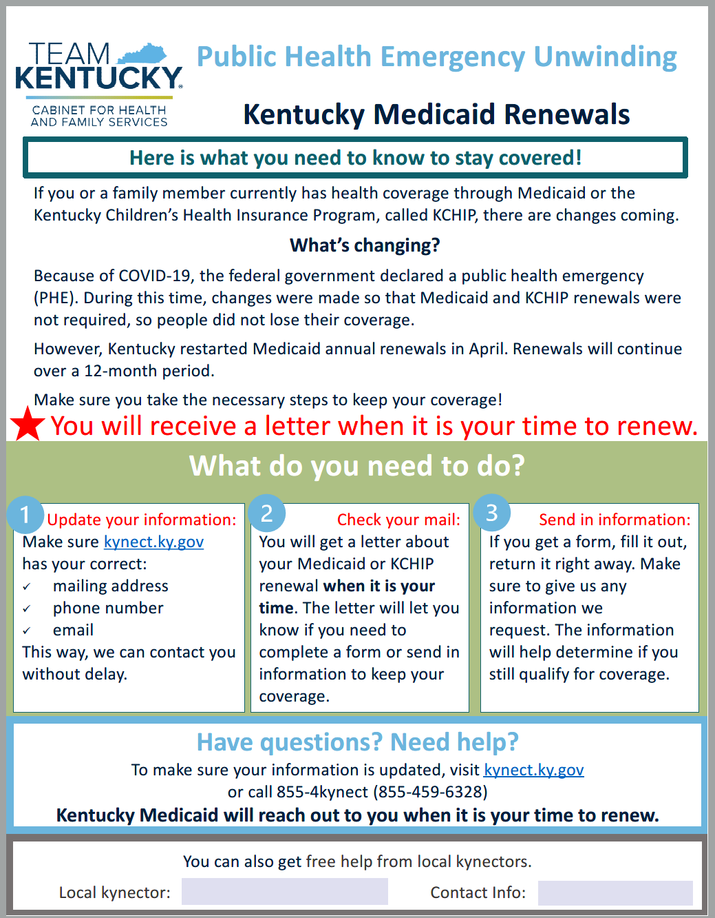
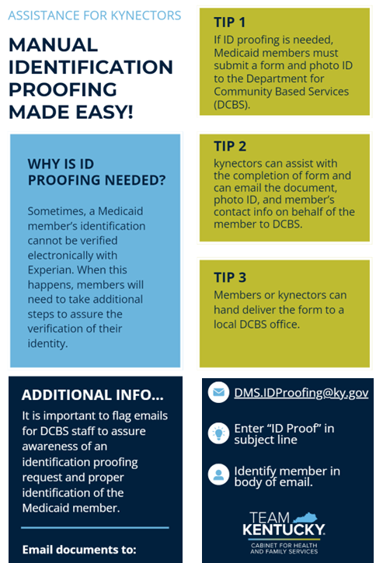
Help us get the message out! Informational fliers available on PHE website in English and Spanish!
Reinstatement Information
Materials for Offices
Editable Fliers for kynectors
ID Proofing Tips
22
Notes:
Children have specific renewal requirements – KY focusing heavily on this population and ongoing outreach
Respond even if you think you are not eligible
Main importance is getting individuals to respond/act

Slide 23
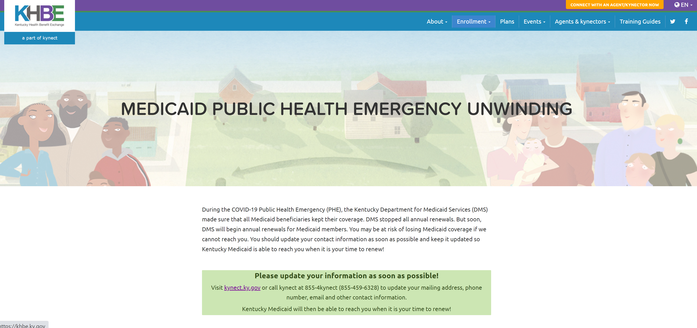
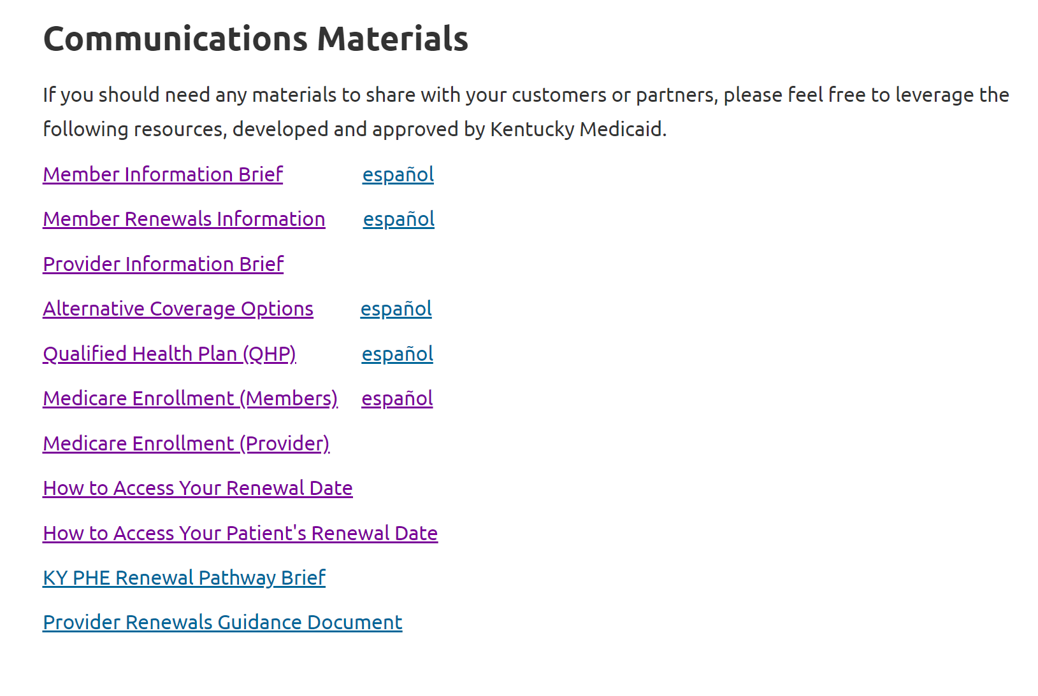
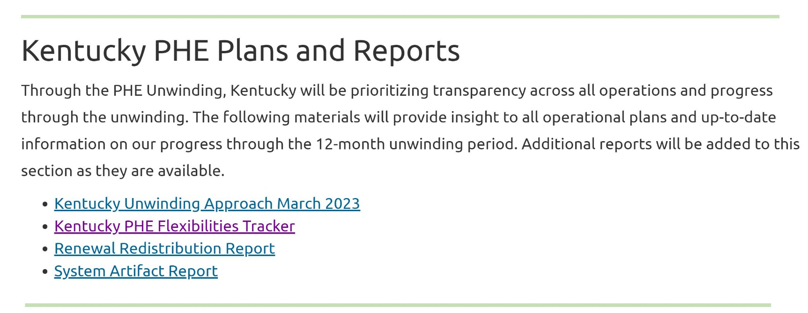
KY PHE Website Resources
https://medicaidunwinding.ky.gov
Stakeholder Session Information
KY PHE Reports
FAQs
Medicaid Member Information
Medicaid Provider Information
Communication Materials
23

Slide 24
Reentry Update

Slide 25
Reentry 1115 Project Timeline
Oct. 30, 2024
Dec. 29, 2024
Summer-Fall 2025*
Implementation Plan Due to CMS
Reinvestment Plan Due to CMS
Implementation upon CMS approval
Current
Nov. 29, 2024
Dec. 29, 2024
Implementation Plan Development
Monitoring Protocol Due to CMS
Evaluation Design Due to CMS
25
Notes:
Implementation Plan Due to CMS 10/30
Completed stakeholder engagement early this month to support mapping of current state and identify needs/gaps
This included focus groups, interviews, data requests and working sessions with:
Individuals with lived experience
providers
MAT Providers
Primary care provider
State agencies including DPH, AOC, DAIL, DCBS, MCOs
Currently reviewing complete GAP analysis and current state assessment which will drive next steps toward identifying action steps
The implementation plan will still be somewhat high-level, we will continue work regarding the finer details of implementation while CMS is reviewing the plan
ACRES Advisory Committee meeting last week to provide preliminary GAP Analysis findings
CORE Team is meeting bi-weekly and will begin discussing some of the key decision points
Weekly Workgroups with DOC and DJJ
Following implementation plan submission, monitoring protocols are due 11/29 and the evaluation design and reinvestment plan due 12/29

Slide 26
Consolidations Appropriations Act (CAA)
The 2023 Consolidated Appropriations Act (CAA), Congress amended existing laws that limit Medicaid and CHIP coverage for incarcerated individuals.
CMS released guidance July, 2024 regarding provisions under CAA to take effect on January 1, 2025.
Eligible Population
Adjudicated juveniles under 21 years of age; or between the ages of 18 and 26 former foster care children group. Eligibility is suspended upon incarceration/placement.
Covered Services
Early and Periodic Screening, Diagnostic, and Treatment Services (EPSDT): Includes medical, dental, and behavioral health screenings or diagnostic services. Targeted Case Management 30 days prior to release and for at least 30 days after release.
Possible Settings
Youth Development Centers Youth Detention Centers State Prisons Local Jails

Slide 27
Division of Health Plan Oversight: Provider Appeals and Complaints

Slide 28
Appeals and Complaints Branch
MCO denials, in whole or in part, a service or claim
Provider
907 KAR 17:015 Provider Appeals
Member
907 KAR 17:010 MCO Member Appeals
907 KAR 1:563 State Fair Hearing and Non-MCO Appeals
907 KAR 17:035 External Independent Third-Party Review
907 KAR 17:040 Administrative Hearing
KRS 205.646
MCO Appeal Process
Two Paths to Appeal
28

Slide 29
Appeals and Complaints Branch
Providers may appeal on behalf of the member, but it is still considered a member appeal.
Member must provide written consent for their provider to represent them in an appeal.
Must be received by the MCO within 60 days from the date of the adverse determination notice.
Non-expedited appeals must be decided within 30 days.
Expedited appeals must be decided within 3 business days.
Continuation of services is allowed.
If service is denied in whole or in part, member has 120 days to request state fair hearing.
Member Appeals
29

Slide 30
Appeals and Complaints Branch
Timeframe for provider to request is determined by MCO provider internal appeal process.
There is only one provider internal appeal and it applies to prior authorizations, service denials, claim denials, etc.
MCO must make an internal appeal decision within 30 days.
Peer to peer reviews are not required, but may occur separately from the internal process. This does not affect the 30-day decision requirement.
14 day extensions shall be granted if requested by the MCO or provider.
Include all documentation to support the appeal.
Upon receipt of the final internal appeal decision, providers have 60 days to request an External Independent Third-Party Review
Provider Appeals
30

Slide 31
External Independent Third-Party Review (EITR) Process
MCO internal appeal decision
Provider has 60 days from appeal decision to send an EITR request to the MCO
MCO must notify DMS, provider and member within 5 business days
MCO has 15 business days to upload documentation to IPRO
DMS will notify MCO and provider of external reviewer
Reviewer has 30 days to review and issue final decision
MCO notify member within 10 business days of receiving final decision
MCO or provider has 30 days to request administrative hearing
KRS 205.646 or 907 KAR 17:035
Always make the request in writing and submit ALL documentation that supports the reason you disagree with the decision.
31

Slide 32
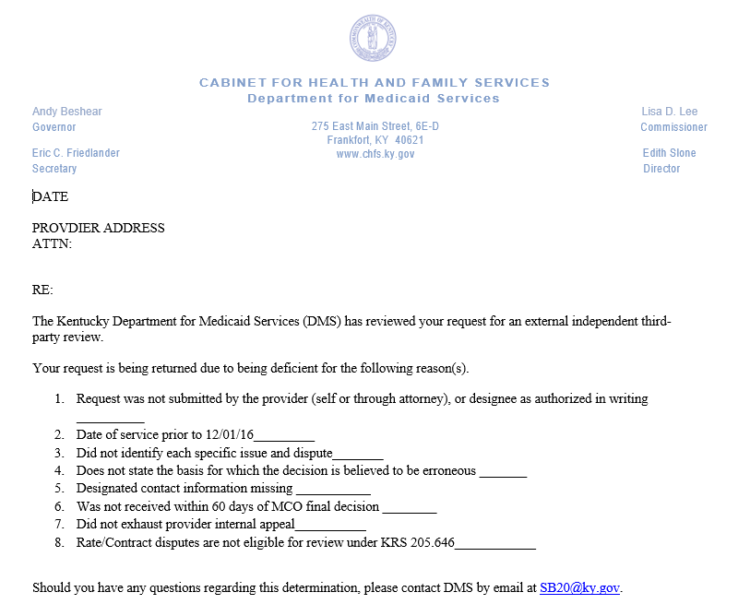
Denial of an External Independent Third-Party Review Request
Questions/Inquiries
SB20@ky.gov
32

Slide 33
Provider Administrative Hearing
Must be requested within 30 calendar days of the external independent third-party review decision.
May be requested by either the MCO or provider.
The party that receives the adverse final order pays a fee of $600 to the Department within 30 days.
SEND REQUESTS TO:
Department for Medicaid Services
ATTN: Administrative Hearing Request
275 E Main Street, 6E-D
Frankfort, KY 40621
DMS.Hearings@ky.gov
Phone: 502-564-9394
Fax: 502-564-0223
HEARINGS CONDUCTED BY:
Office of the Attorney General
Families and Children and Health Services Division
105 Sea Hero Road, Suite 2 Frankfort, Kentucky 40601
Phone: 502-696-5442
33

Slide 34
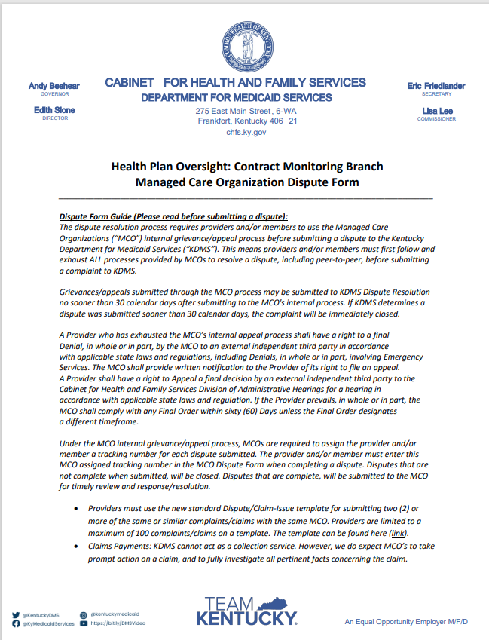
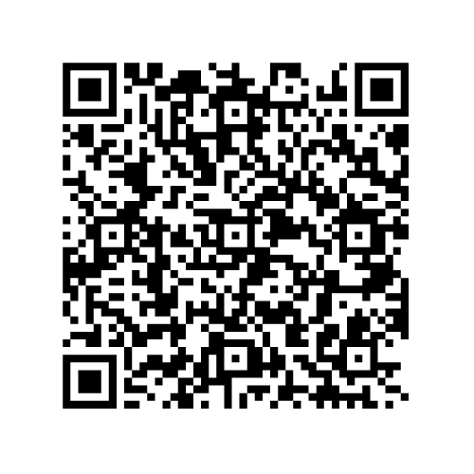
Managed Care Organization Dispute Form
ProviderMCOInquiry@ky.gov
34

Slide 35
Key Takeaways - Provider Complaints
Always contact the provider representative first.
Provide all documentation that applies to the complaint(s) including email correspondence, a brief description of issue, claims information, etc….
Identify the MCO(s) when requesting a complaint. This is important if a provider has similar issues with multiple MCOs.
If a provider has gone through the MCO internal appeal process and wants to file a complaint include that information in the complaint.
35

Slide 36
Program Spotlight: Medicaid’s Behavioral Health Initiatives

Slide 37
Behavioral Health Services
Inpatient
SUD Residential
Outpatient
Supportive Services
State Plan Covered Services
Kentucky Medicaid expanded in 2014 as a part of the Affordable Care Act.
Medicaid includes coverage of behavioral health services, including mental health and substance use disorders.
37
Notes:
Reentry Section 1115:
Medicaid coverage for certain transitional services to identified individuals who are soon-to-be former inmates of designated public institution to ensure continuity of health care coverage pre- and post-release and facilitate warm linkages to medical and behavioral health services upon release.
Substance Use Disorder (SUD) Section 1115:
Allows reimbursement for SUD residential treatment as a statewide average length of stay of 30 days, and
Waives the Institution for Mental Disease (IMD) Exclusion to allow reimbursement for up to 96 beds​ for programs that meet qualifications and standards required under Demonstration milestones.
Eligibility for out of state former foster care youth (FFCY):
Extends Medicaid eligibility to FFCY aged 18 to 26, and who were in foster care under the responsibility of another state.
Serious Mental Illness (SMI) Section 1115
Reimburse medically necessary short-term, defined as a state-wide average length of stay no longer than 30 days, inpatient treatment services within settings that qualify as IMDs for adults with serious mental illness (SMI).
Recuperative Care Pilot
Request authority to reimburse for recuperative care services, also known as medical respite care, to adult beneficiaries who are homeless or at risk of homelessness requiring additional medical support and care coordination following a hospital stay.
Recovery Residence Support Service (RRSS)
Request authority to reimburse up to 90 days for Recovery Residence Support Services (RRSS) for eligible adults with an SUD who are soon-to-be former inmates of designated public institution or participating in the Kentucky Behavioral Health Conditional Dismissal Program.

Slide 38
TEAM KY 1115 Components
Kentucky’s Section 1115 Demonstration entitled “TEAMKY (formally known as Kentucky Helping to Engage and Achieve Long Term Health (KY HEALTH))” was approved January 2018.
TEAMKY Section 1115 Demonstration
(Project Number 11-W-00306/4)
SUD 1115
5-Year Extension
Pending Approval
Out of State FFCY
5-Year Extension
Pending Approval
Recuperative Care Pilot
Pending Approval
SMI 1115
Pending Approval
Recovery Residence Support Service (RRSS)
Reentry 1115
~Approval 7/2/24
Current Demonstration is approved through September 30, 2024.
38
Notes:
Reentry Section 1115:
Medicaid coverage for certain transitional services to identified individuals who are soon-to-be former inmates of designated public institution to ensure continuity of health care coverage pre- and post-release and facilitate warm linkages to medical and behavioral health services upon release.
Substance Use Disorder (SUD) Section 1115:
Allows reimbursement for SUD residential treatment as a statewide average length of stay of 30 days, and
Waives the Institution for Mental Disease (IMD) Exclusion to allow reimbursement for up to 96 beds​ for programs that meet qualifications and standards required under Demonstration milestones.
Eligibility for out of state former foster care youth (FFCY):
Extends Medicaid eligibility to FFCY aged 18 to 26, and who were in foster care under the responsibility of another state.
Serious Mental Illness (SMI) Section 1115
Reimburse medically necessary short-term, defined as a state-wide average length of stay no longer than 30 days, inpatient treatment services within settings that qualify as IMDs for adults with serious mental illness (SMI).
Recuperative Care Pilot
Request authority to reimburse for recuperative care services, also known as medical respite care, to adult beneficiaries who are homeless or at risk of homelessness requiring additional medical support and care coordination following a hospital stay.
Recovery Residence Support Service (RRSS)
Request authority to reimburse up to 90 days for Recovery Residence Support Services (RRSS) for eligible adults with an SUD who are soon-to-be former inmates of designated public institution or participating in the Kentucky Behavioral Health Conditional Dismissal Program.

Slide 39
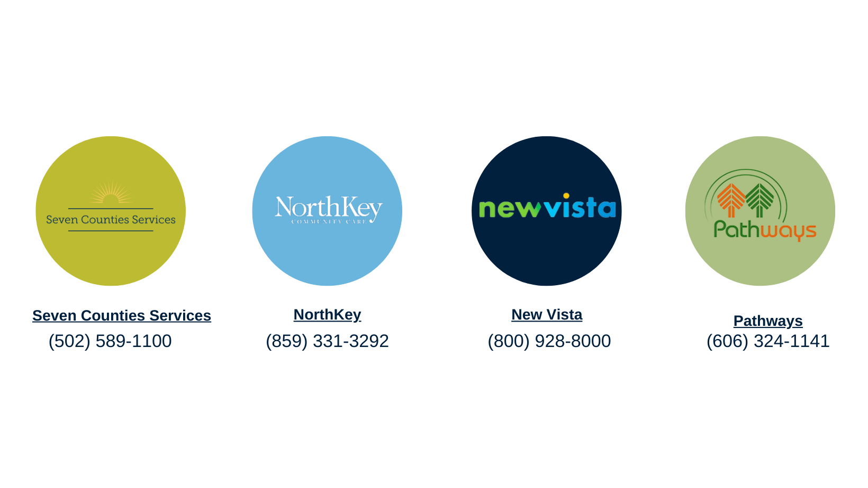
Certified Community Behavioral Health Clinics (CCBHC)
IMPLEMENTED January 1, 2022
Serious mental illness (SMI)
Serious emotional disturbance (SED)
Long-term chronic addiction
Mild or moderate mental illness and substance use disorders
Complex health profiles
CCBHCs must provide care regardless of ability to pay or place of residence, providing care for those who are on Medicaid, uninsured, underserved, homeless, and for active-duty military or veterans.
39

Slide 40
Multisystemic Therapy (MST) Pilot
POPULATION IMPACTED
Medicaid enrolled children between the ages of 10-17 that are at risk for entering the Juvenile Justice system. The goal is to work intensively with the youth and family to prevent justice involvement and out of home placements.
Evidence-Based
Partnerships
Five-Year Project
MST is an evidenced based intensive treatment process that focuses on diagnosed behavioral health disorders and on environmental systems.
DCBS, DJJ, MCOs, and other community providers have referred to the programs during the first year of the pilot.
DMS, along with DCBS, has partnered with 4 Pilot providers that are licensed by the MST Institute for the delivery of this intensive service.
40

Slide 41
Kentucky Behavioral Health Needs Assessment
Assess Kentucky’s Statewide Behavioral Health Needs
Identify Needs and Gaps
Assess Capacity
Understand the behavioral health needs of Kentucky’s population, including mental health and SUD services. Identifies gaps and inefficiencies in the current system, providing a basis for improving service delivery.
Assess provider network and system capacity to address the needs of populations served.
Inform Policy &
Program Development
Enhance Service,
Quality, & Outcomes
Inform Kentucky policymakers regarding the Commonwealth’s current behavioral health landscape, enabling data-driven decisions for effective policy change and program design. Guide the allocation of funding and resources to areas with the greatest need.
Evaluate current service delivery models and identify best practices and evidence-based interventions to improve the quality of behavioral health services and patient outcomes.
Improve Access to Services
Promote Equity
Identify disparities in behavioral health access and outcomes, promote strategies to address these inequities, and ensure services are available across the state.
Ensure the voices of diverse communities are heard and considered in the planning process through stakeholder engagement to develop collaborative solutions.
41
Target Publication: Q4 2024.
Notes:
Project Purpose: Kentucky’s statewide behavioral health needs assessment provides a comprehensive overview of the current behavioral health landscape and highlights critical areas of opportunity. The needs assessment helps to:

Slide 42
42

Slide 43
Open call for topics of interest!
What would you like to hear more about from the Cabinet?

